Slide 2
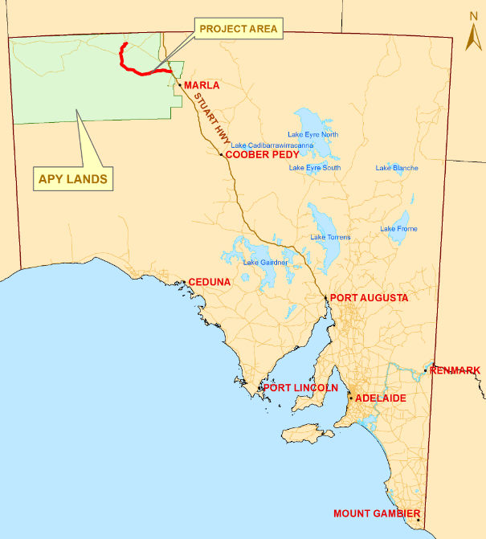
Notes:
The APY Lands are located in the remote north west of South Australia.
It has a population of around 2500 people.
The APY Lands cover approximately 102,000 km² – all of South Australia is 984,000 km²
Distance from Adelaide to Indulkana, the southern most Community (by road) is approx 1130km’s – around 11 hours in a vehicle.
Or, a 2 hour flight from Adelaide to Coober Pedy, and then a 3 hour drive north to Indulkana.
The main communities on the Lands include: Indulkana, Mimili, Fregon and Pukatja.
There are several homelands as well.
The APY administration centre of the Lands is located in Umuwa.

Slide 3
Locality Plan
Notes:
210km of APY Main Access Road and 21km of Community Access Roads
The upgraded road will
improve road safety
Improve travel between communities
Improve accessibility to communities
Improve emergency responses:
Medical
Police

Slide 4
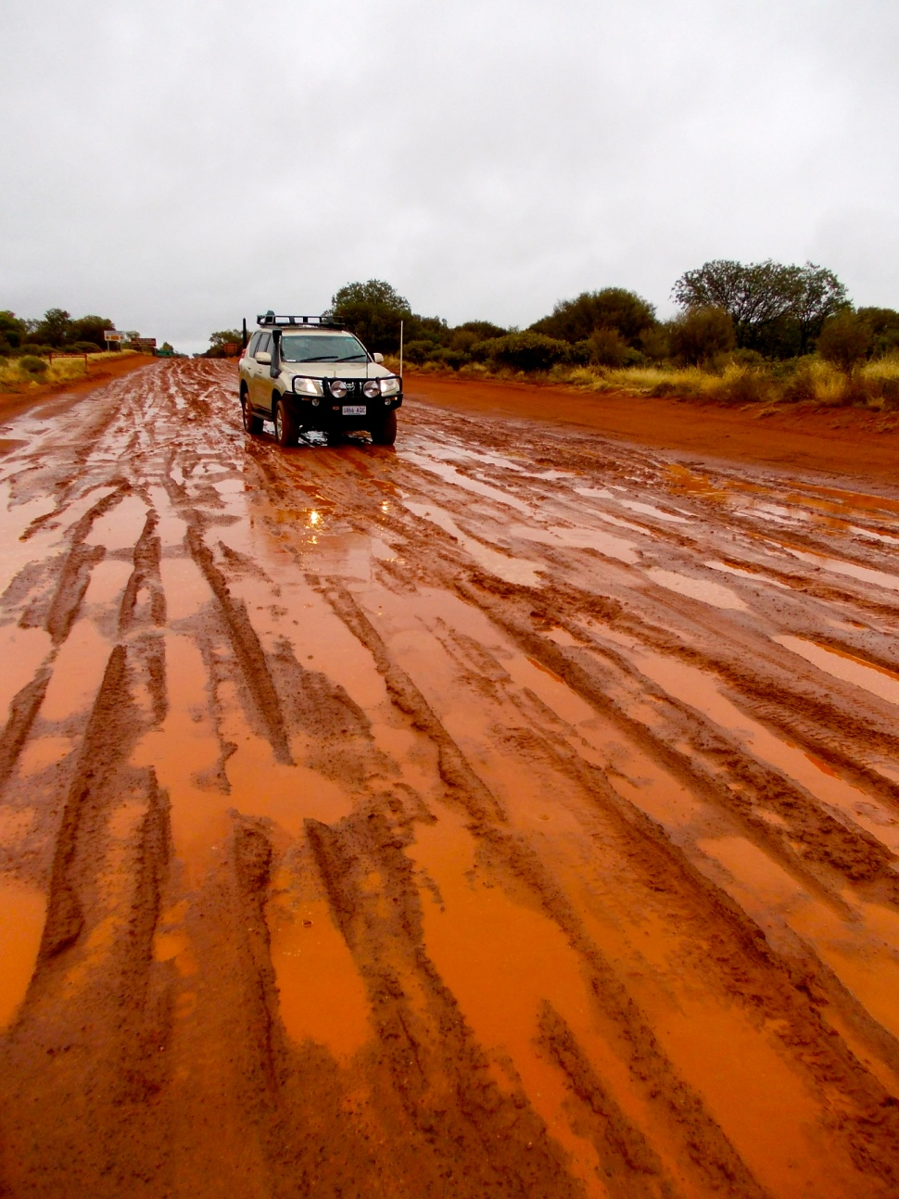
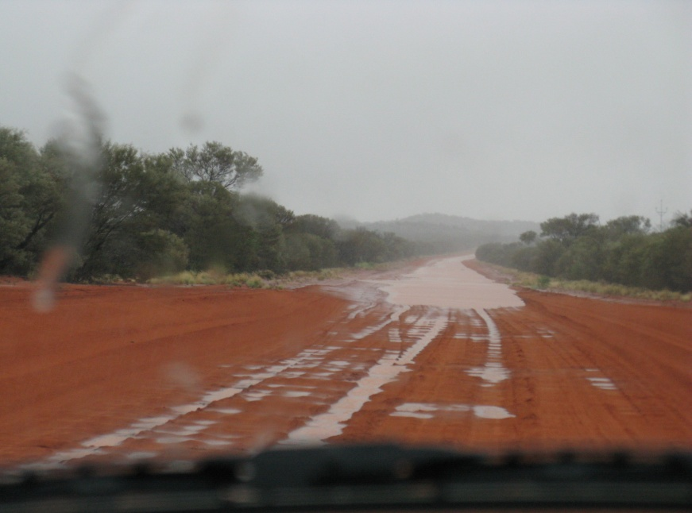
Notes:
In the wetter months, because the Main access road is below natural surface there is frequent flooding of the road and can sometimes be impossible to drive through

Slide 5
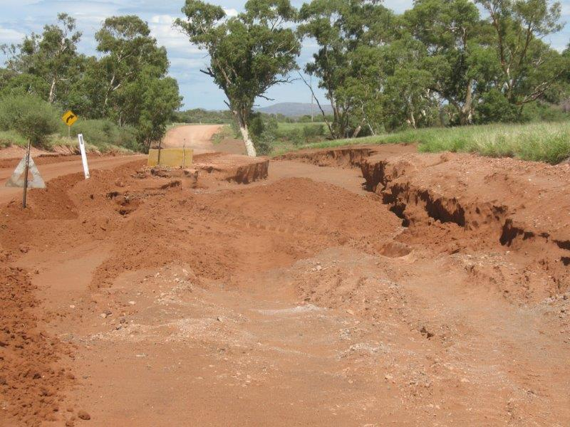
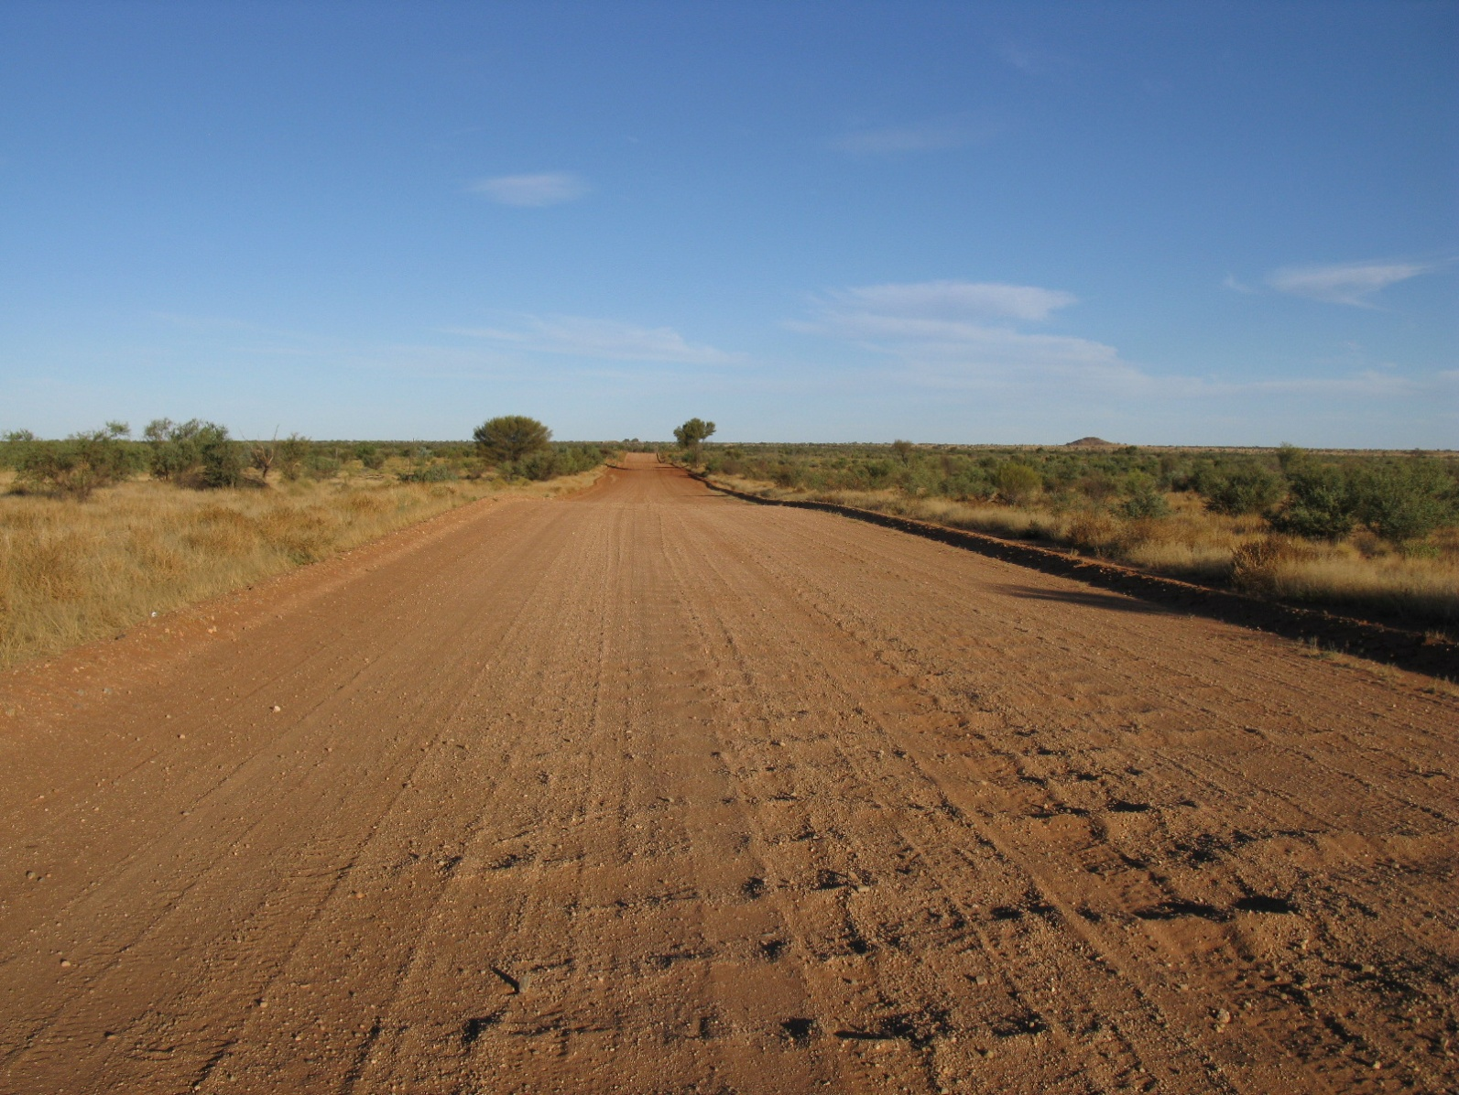
Notes:
In the warmer months, the Main Access Road is highly corrugated

Slide 6
PROCUREMENT
Project Timeline for each of the 5 sections
Request for Tender
Called
Commence Construct only contract.
Construction of each stage approx. 40kms
Proposed dates for calling tenders
Section 1 – June 2015 - $15m
Section 2 – April 2016 - $20m
Section 3 – November 2016 - $20m
Section 4 – April 2017 - $20
Section 5 – January 2018 - $15m
A number of smaller contracts for minor works and pre-construction works are also planned.
Notes:
Still investigating whether the contracts will be called as one or separate contracts.
Major contract works include forming existing local fill material (cut to fill), sheeting the road and stabilising floodways.
First crushing contract for 90,000T has been called already.
Two trial pavement sections are to be called in the coming month – one for 7km and one for 4.5 km
Other smaller contracts may include turkey nest construction and crushing.

Slide 7
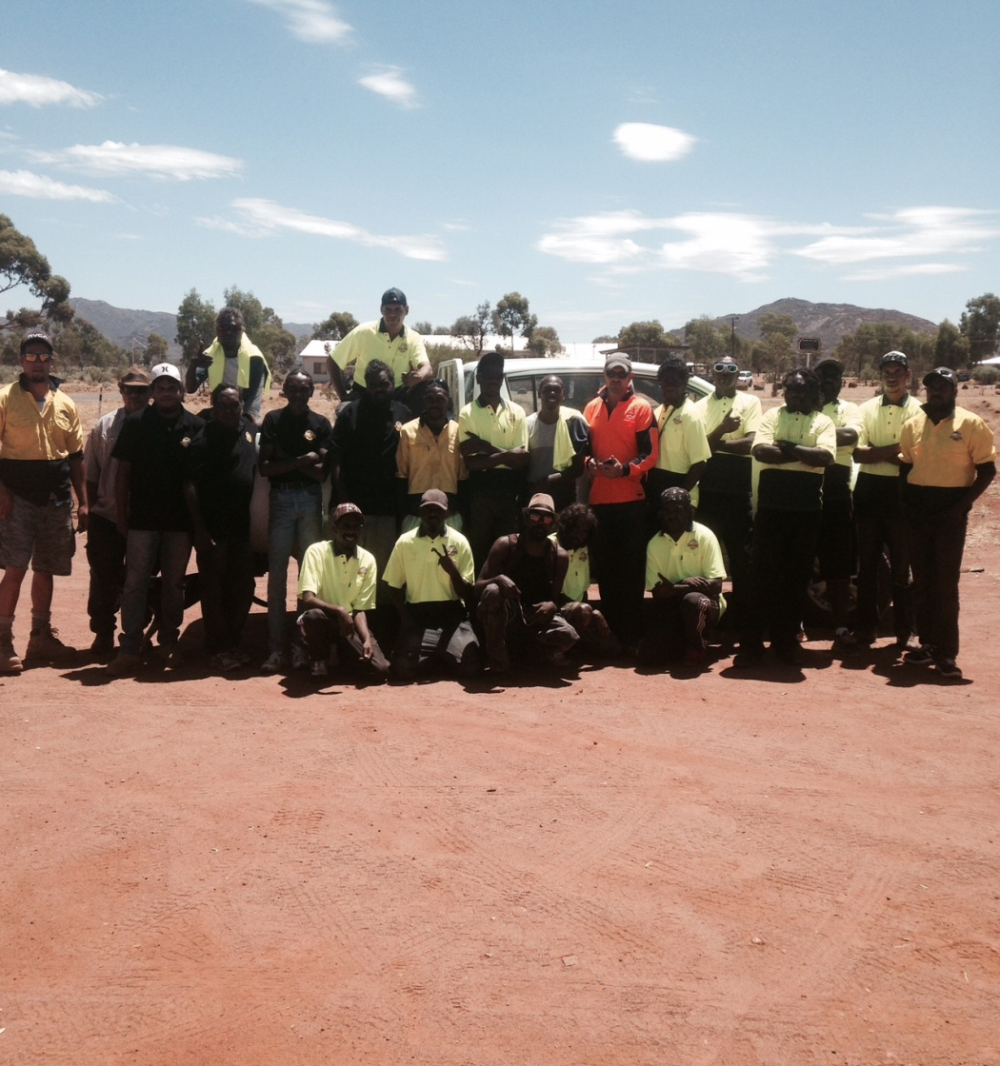
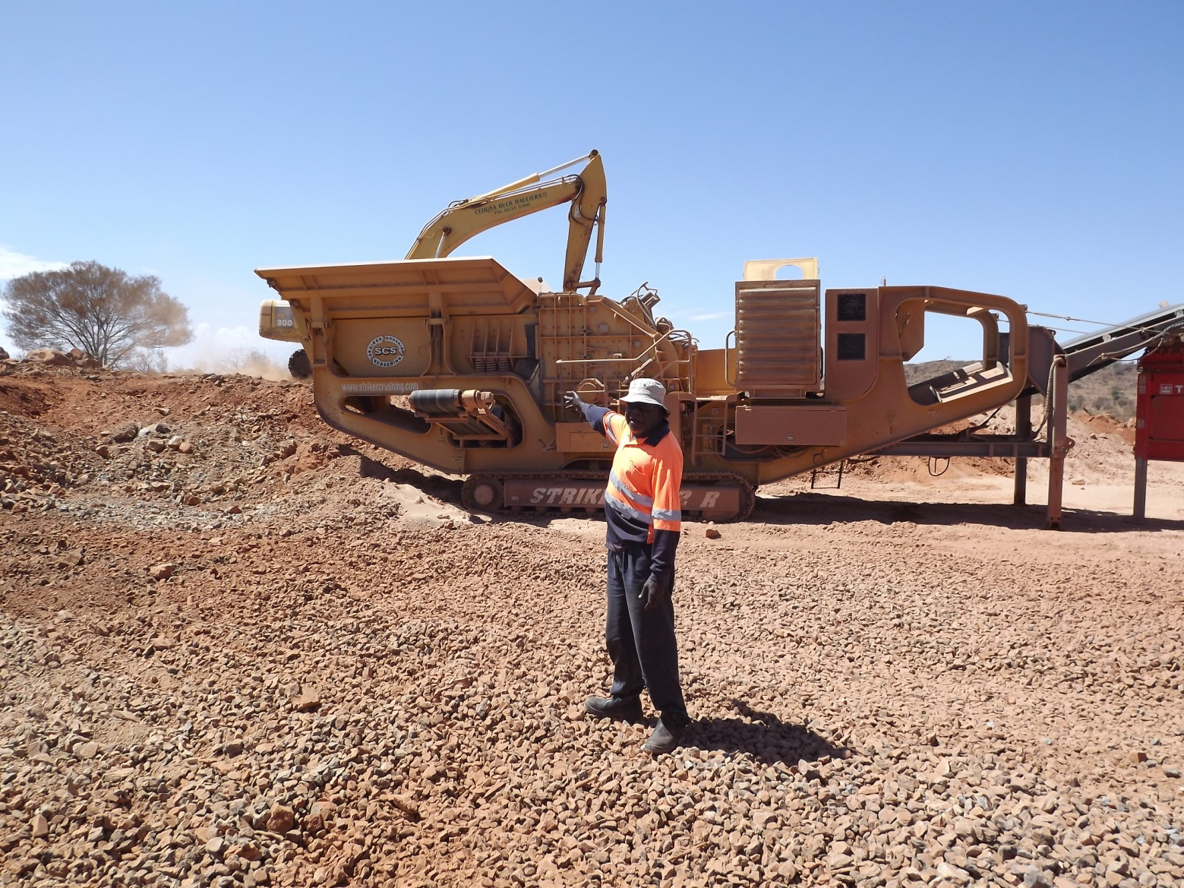
EMPLOYMENT
Notes:
We have engaged a number of monitors and traditional owners throughout our early works phase
Survey assistants have been used for engineering survey works from Umuwa to Pukatja
A number of other organisations are being consulted regarding employment possibilities, including RASAC, the APY Executive Board and local workers.

Slide 8
EMPLOYMENT
A key to the success of the project will be employment of local Anangu people
Training placements for local Aboriginal people
Commitment to a minimum of 30% of labour hours to be undertaken by local Aboriginal people
Contract requirements for employment and training of local Aboriginal people
Consider ways of maintaining employment for local Aboriginal people
Notes:
Aboriginal employment
There is an agreed 30% minimum employment target for local Anangu to be employed on the project. This will involve direct and indirect labour.
Direct possibilities: Traffic Management, Fauna assessment, Liaison officers, Fencing, general labour, plant operators
Indirect possibilities: Administration services, store caterers, cleaners, horticulture etc
Workzone Traffic Management training is currently being conducted by Skill Hire , with a vision for some of these people to work on the road project

